Slide 1
Customer Sentiment and Trend Analysis
Welcome! Our project focuses on understanding and analyzing customer sentiment and trends using cutting-edge data science techniques.
by Ahmad Ashraf
AA

Slide 2
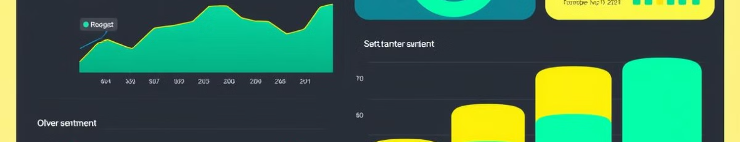
Customer Sentiment and Trend Analysis
1
Uncover Insights
2
Identify Emerging Trends
3
Make Data-Driven Decisions
We delve into customer feedback, social media posts, and online reviews to extract valuable insights about their opinions and preferences.
Our analysis helps businesses stay ahead of the curve by identifying emerging trends and adapting their strategies accordingly.
By understanding customer sentiment, businesses can make informed decisions about product development, marketing campaigns, and customer service strategies.

Slide 3

Task 1: Data Collection and Preprocessing
1
Data Collection
We tried to get data as clean as possible, and finally we got "Sentiment140", which is a dataset with 1.6 million tweets.
2
Data Cleaning
We didn't find null data or missing values, but we found few outliers ,but we ignore it, so we started to preprocess the tweets we got (which will be explain late)
3
Data preprocessing
We transform the tweets into a format suitable for analysis, by removing stop words and URLs, then we tokenize the tweets.

Slide 4
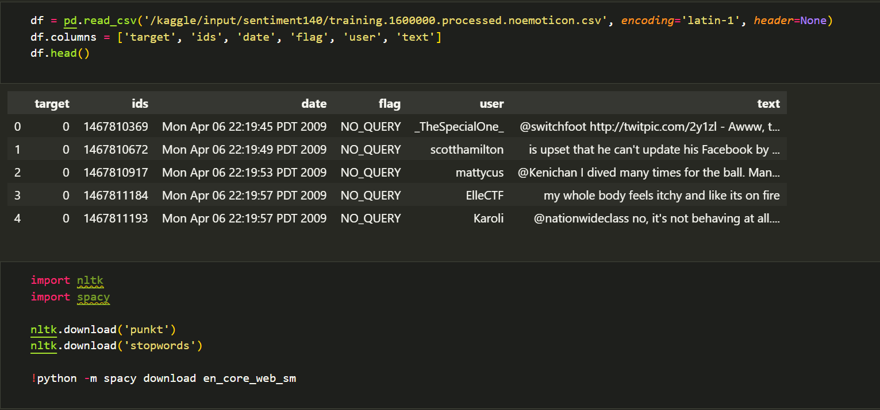

Slide 5
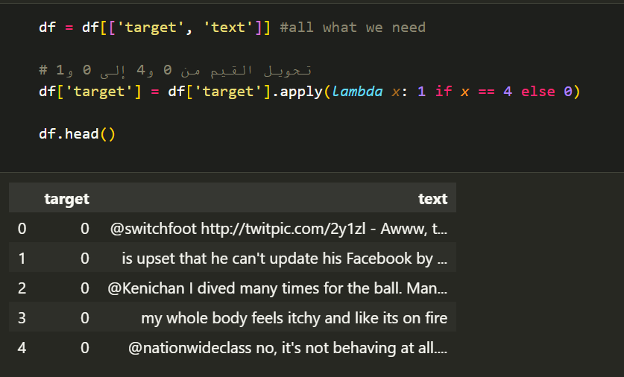
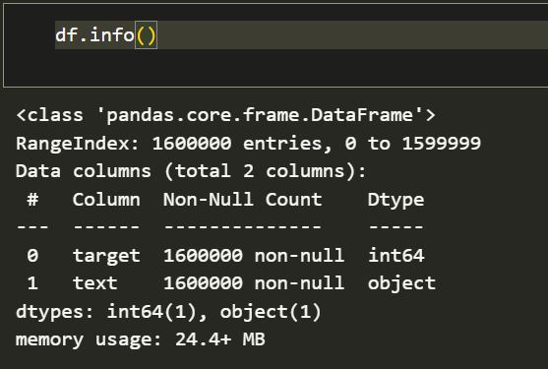

Slide 6
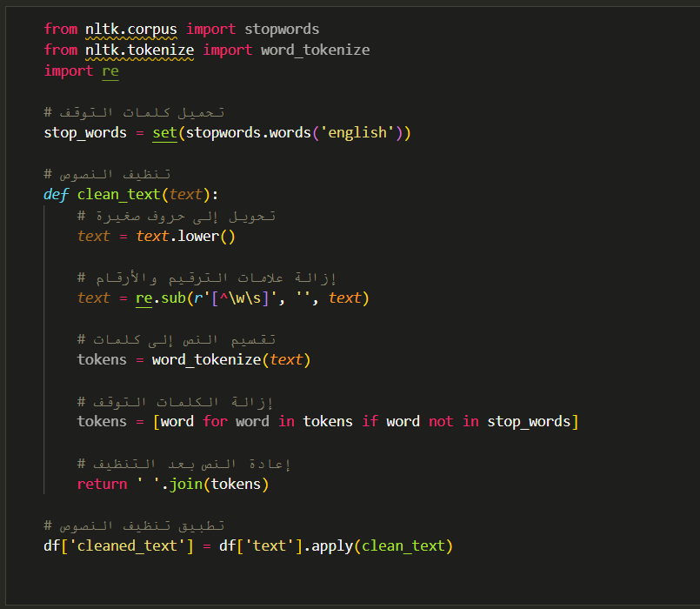

Slide 7
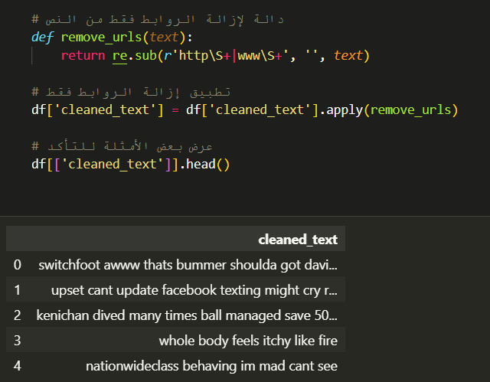
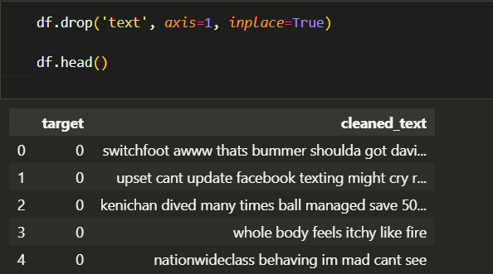

Slide 8
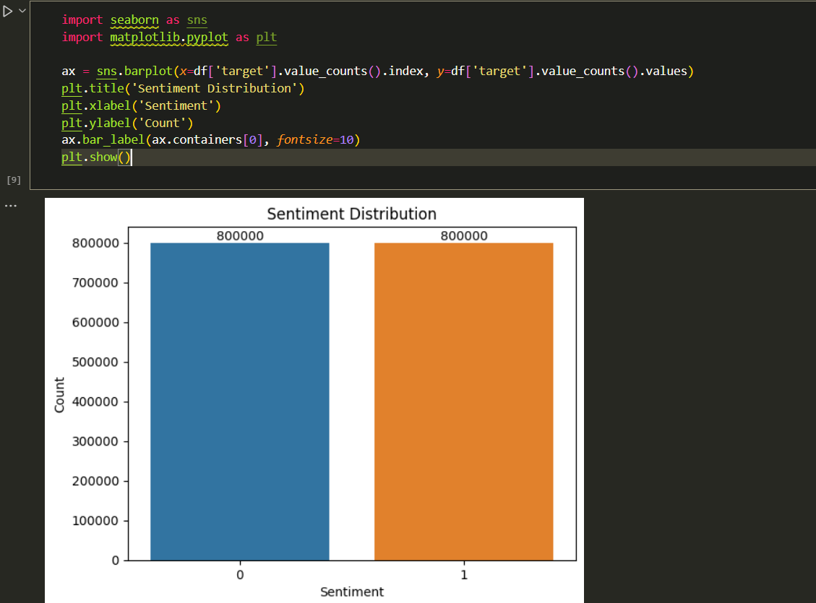

Slide 9
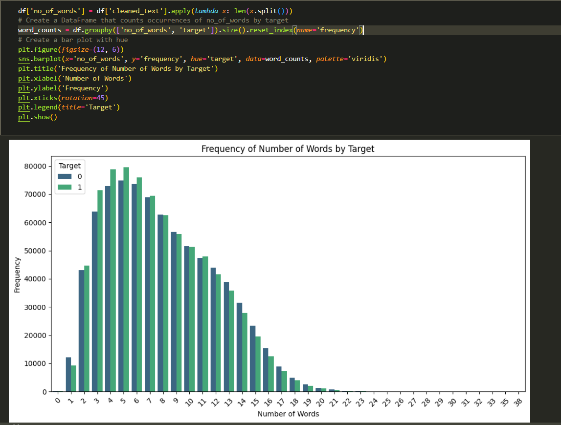

Slide 10
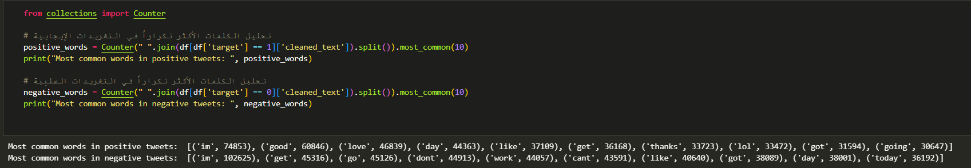
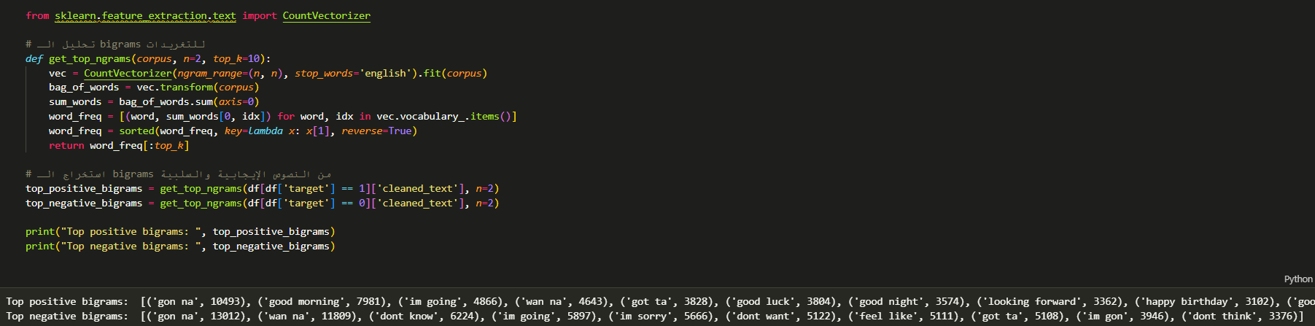

Slide 11
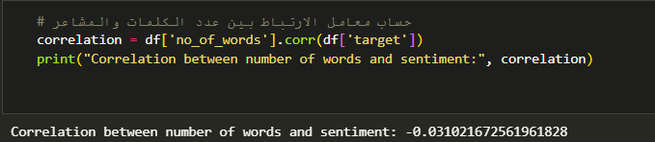

Slide 12
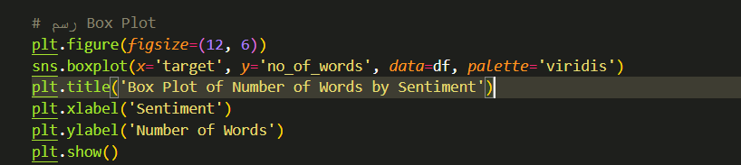
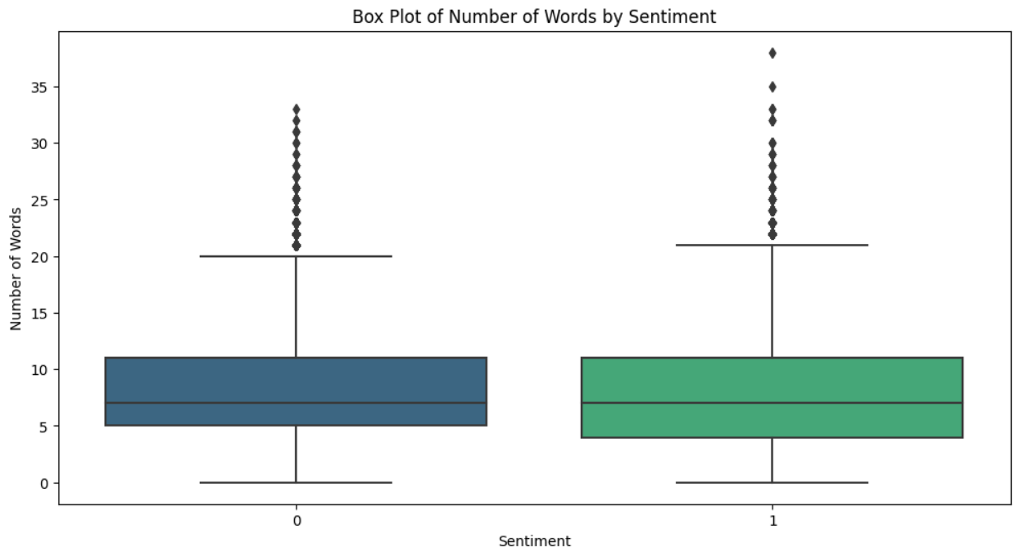

Slide 13
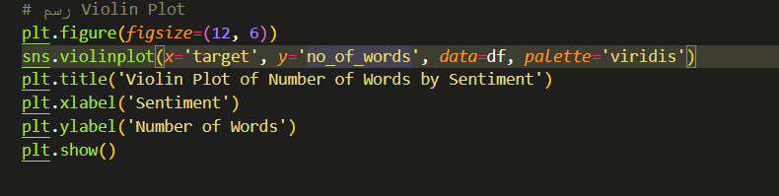
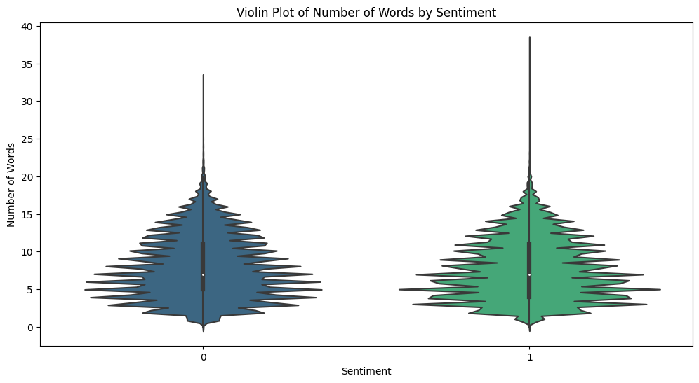

Slide 14
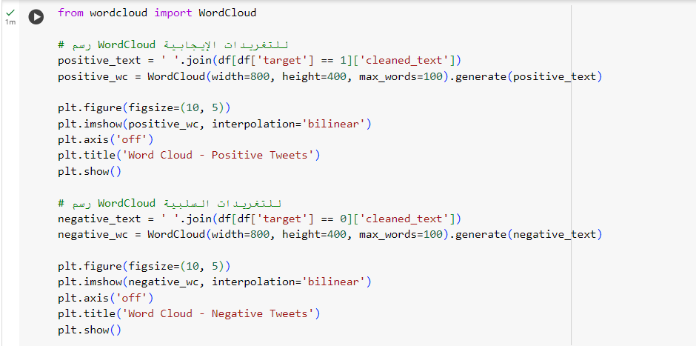
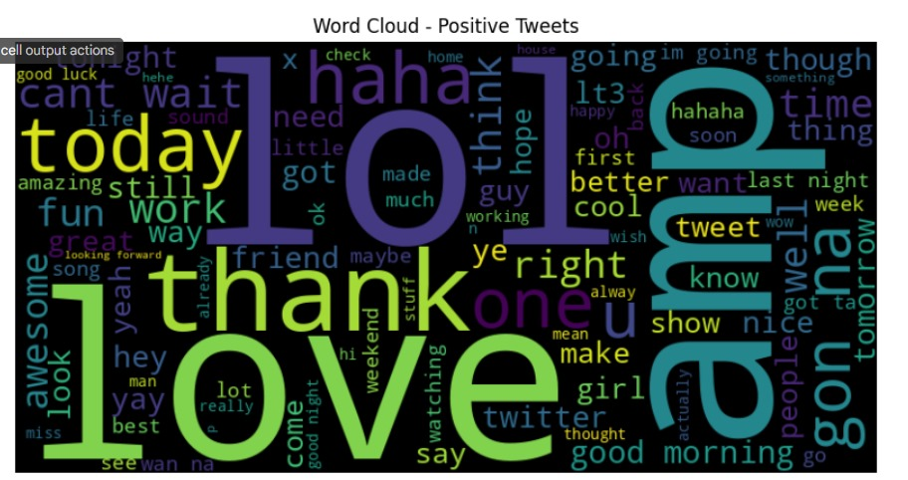
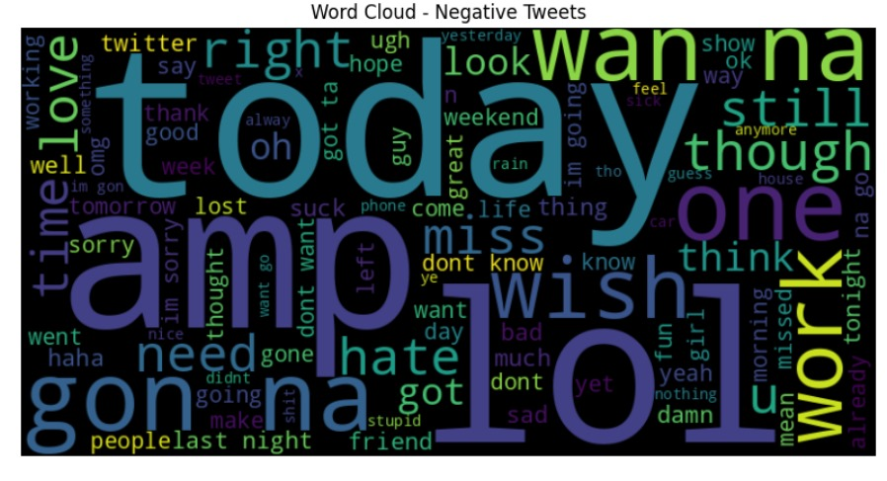

Slide 15
Task 2: Data Science and Machine Learning
Exploratory Data Analysis (EDA)
Model Selection and Training
Model Evaluation and Optimization
We use statistical techniques and data visualization (Sentiment Distribution, Tweet Length Distribution, Most Common Words, WordCloud, N-grams, Correlation Analysis ) to understand the characteristics of the data, identify patterns, and uncover hidden insights.
We choose Random Forest algorithm, such as sentiment analysis models, and train them on the processed data.
We evaluate the performance of the trained models using various metrics and refine them to achieve optimal accuracy and efficiency.
We Used :
Grid search
Classification report

Slide 16
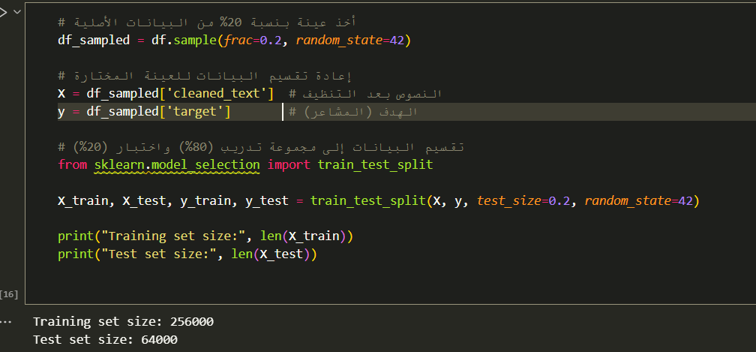

Slide 17
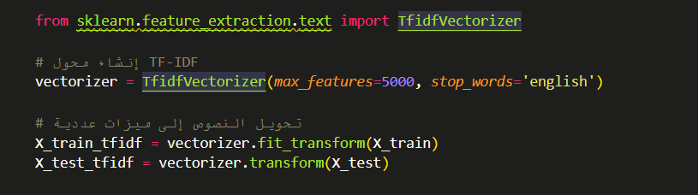

Slide 18
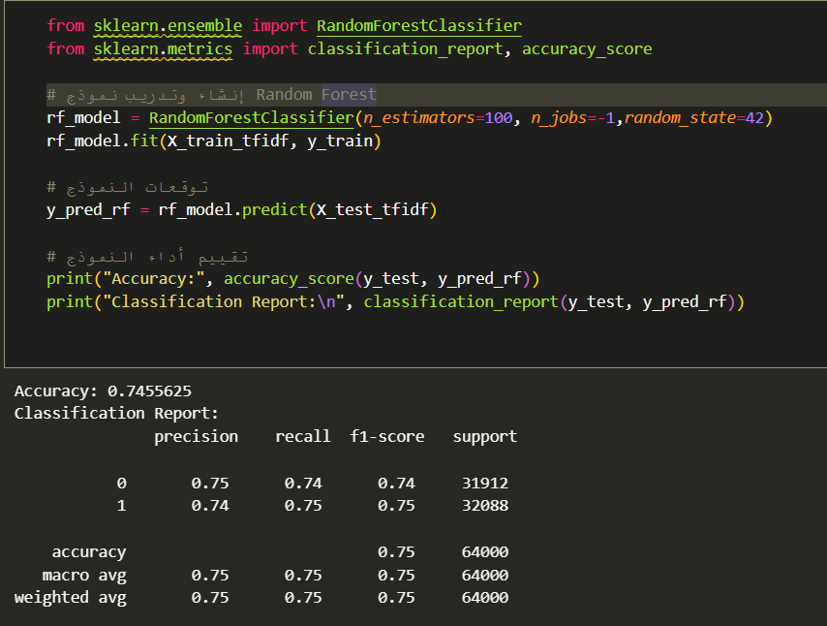

Slide 19
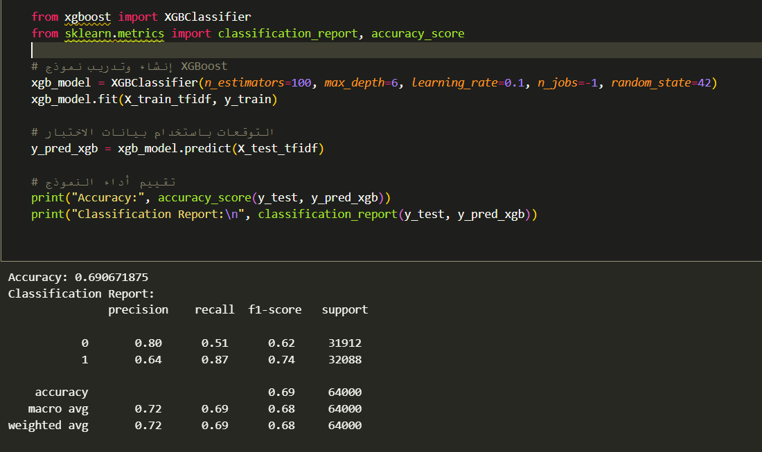

Slide 20
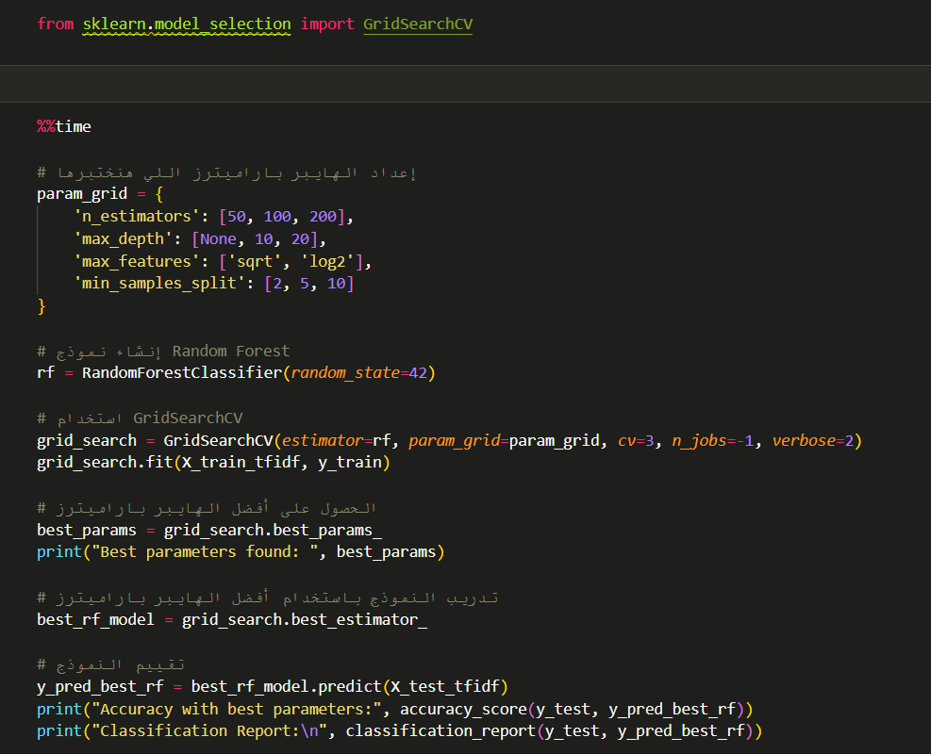

Slide 21
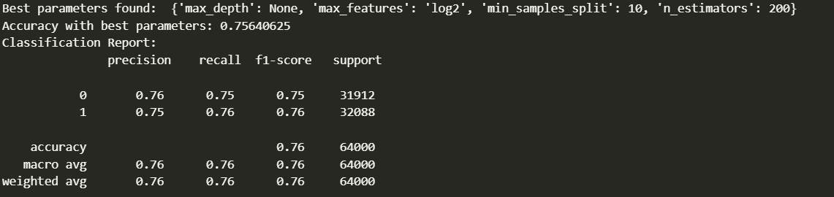

Slide 22
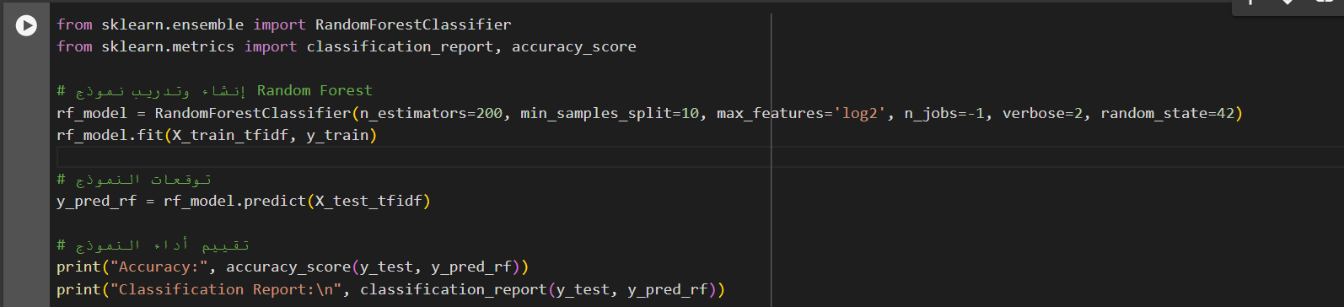
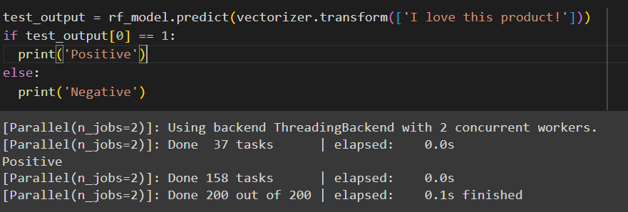

Slide 23
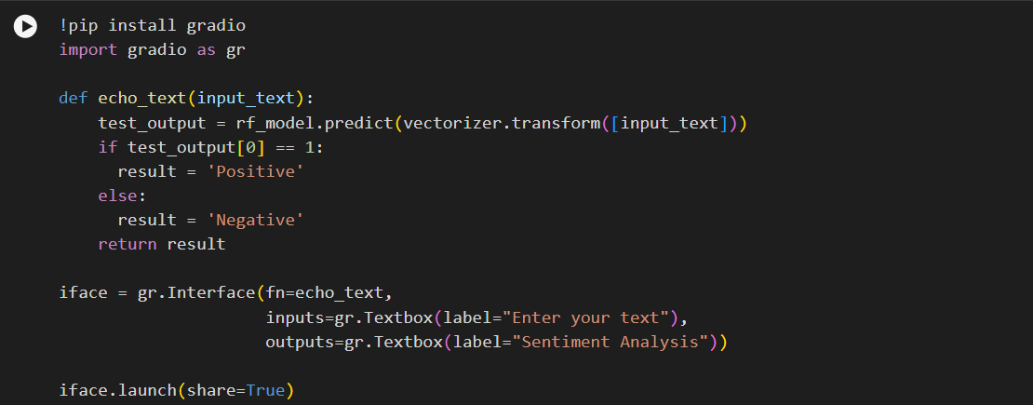
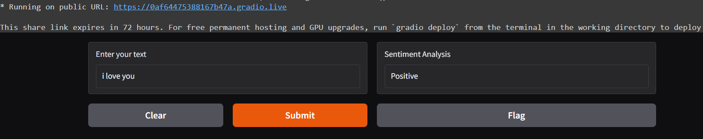

Slide 24
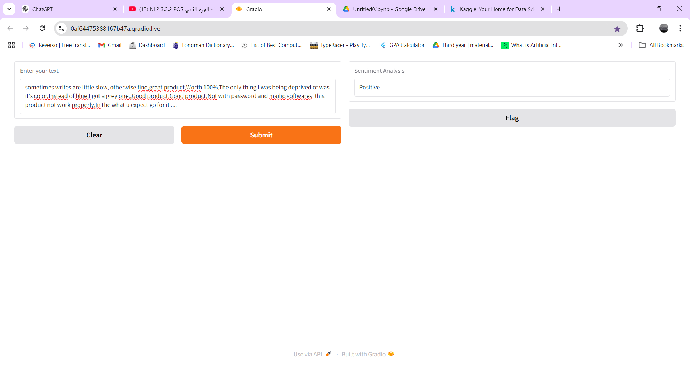

Slide 25
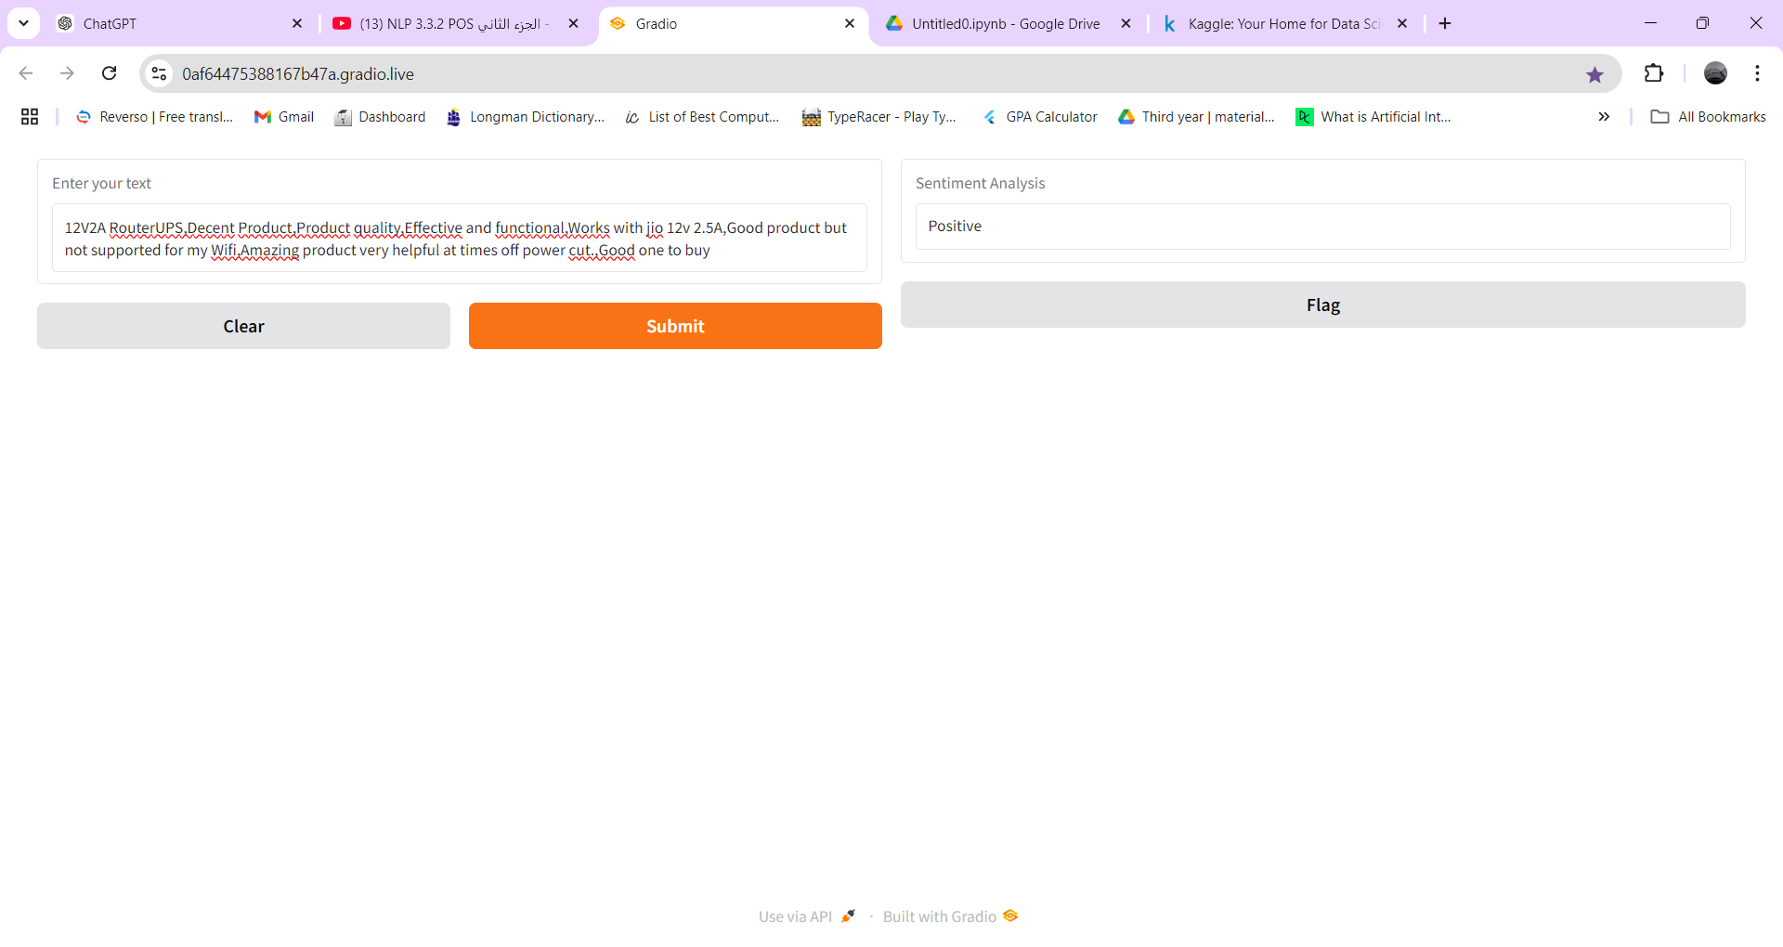

Slide 26
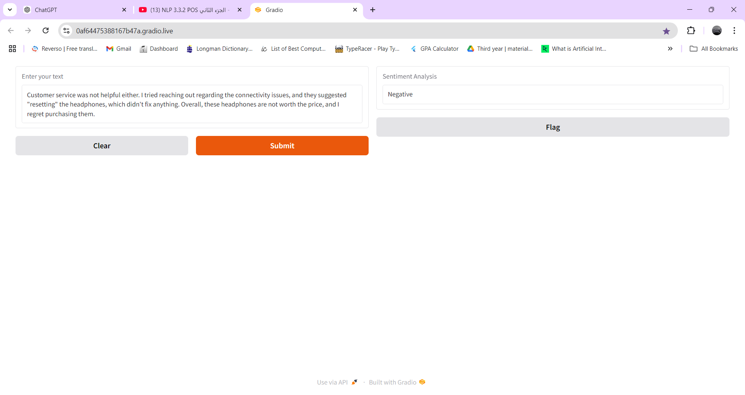

Slide 27
